Slide 1


St. MARTIN’S ENGINEERING COLLEGE
UGC Autonomous
NBA & NAAC A+ ACCREDITED
Dhulapally, Secunderabad– 500100
Department of Artificial Intelligence & Machine Learning
Automatic Grading Of Programming Assignments:An Approach Based On Formal Semantics
Batch No: 17
1. P. Gourav (21K81A7348)
2. G. Yagna Pavan (21K81A7313)
3. R. Ashok Kumar (21K81A7350)
Under the Guidance of
Mrs. G.Kiranmai
Assistant Professor
Department of Artificial Intelligence and Machine Learning

Slide 2
OUTLINE
Abstract
Introduction
Literature Survey
Existing System
Proposed System
System Requirements
System Modules
Detailed Design
9. Flow Chart
10. Algorithms
11. Results Obtained
12. References
13. Python Modules
14. Code

Slide 3
ABSTRACT
Programming assignments grading can be time consuming and error-prone if done manually. Existing tools generate feedback with failing test cases. However , this method is inefficient and the results are incomplete. Machine learning technology is used in this project. In this paper, we present AUTOGRADER, a tool that automatically determines the correctness of programming assignments and provides a counterexamples given a single reference implementation of problem. Instead of counting the passed tests, our tool searches for semantically different execution paths between a student’s submission and the reference implementation. Instead of counting the passed tests, our tool searches for semantically different execution paths between a student’s submission and the reference implementation.

Slide 4
INTRODUCTION
Providing prompt feedback on programming problem submissions encourages students to adaptively learn coding skills and allows instructors to collect real-time information about how their teaching goals are being met.
Manual grading can be both time consuming and error prone , especially when instructors are teaching large-sized classes.
We use weakest precondition symbolic execution to capture the semantics of execution paths and detect potential path difference.
It also reduces human efforts in writing test cases and makes the grading more complete.
We implement AUTOGRADER and test its effectiveness and performance with real world programming problems and student submissions collected from an online programming site.

Slide 5
INTRODUCTION
The goal of our work is to automatically decide the correctness of student programming assignments according to a reference implementation.
Our experiment reveals that there are no false negatives using our proposed method.
We can determine the correctness of the submission and provide counter examples for an incorrect submission.
These makes the grading more complete and these is better way to get the feedback fastly.
These project reduces human efforts in writing test cases.That is one of the best thing of these project.

Slide 6
LITERATURE SURVEY
S.No | Author | Title | Year | Contributions
1. | L. Gong | Auto-grading dynamic programming language assignments", Tech. Rep. | 2014 | Auto-grading system finds bugs, grades, and provides feedback in JavaScript.
2. | N. Tillmann, J. De Halleux, T. Xie, S. Gulwani and J. Bishop | Teaching and learning programming and software engineering via interactive gaming", Proceedings of the 2013 International Conference on Software Engineering ser. ICSE ’13. | 2013 | Educational coding game with levels, leaderboard, and automated grading engine.
3. | R. Singh, S. Gulwani and A. Solar-Lezama | Automated feedback generation for introductory programming assignments", Proceedings of the 34th ACM SIGPLAN Conference on Programming Language Design and Implementation ser. PLDI ’13. | 2013 | Study tested feedback types; hints were ineffective for student improvement.

Slide 7
LITERATURE SURVEY
S.No | Author | Title | Year | Contributions
4. | D. S. Weld, E. Adar, L. Chilton, R. Hoffmann, E. Horvitz, M. Koch, et al. | Personalized online education - a crowdsourcing challenge", AAAI Workshop - Technical Report, vol. WS-12-08 | 2012 | Crowdsourcing generates ideas for innovation; openness, modularity, and leadership matter.
5. | P. Ihantola, T. Ahoniemi, V. Karavirta and O. Seppälä | Review of recent systems for automatic assessment of programming assignments", Proceedings of the 10th Koli Calling International Conference on Computing Education Research | 2010 | Review of automatic assessment tools: features, approaches, and future research.
6. | M. Stipanovich’s, K. Qian and X. Fu | The automated web application testing (AWAT) system", Proceedings of the 46th Annual Southeast Regional Conference ser. ACM-SE 46 | 2008 | Survey of automated assessment in CS education: techniques, challenges, future directions.

Slide 8
EXISTING SYSTEM
Programming assignments grading can be time consuming and error - prone if done manually.
These existing tools generate feedback with failing test cases. However , this method is inefficient and the results are incomplete.
There are two critical issues affecting test-based grading.First,it can be costly to construct high quality test cases and another problem is with test driven grading is that some tools generate feedback using formal methods if instructors have reference solutions to a programming problem.
Disadvantages
1.Less accuracy.
2.Inefficient and results are incomplete.

Slide 9
PROPOSED SYSTEM
We have proposed a formal semantics based approach for automatically grading programming assignments with a single reference implementation provided by the instructor .
We can determine the correctness of the submission and provide counter examples for an incorrect submission.
We have implemented this novel approach using a tool called AUTOGRADER .
Our method relies on detecting semantic difference between the reference implementation and student submissions.If one or more dissimilarities are found , the submission is decided as incorrect; otherwise , the submission is decided as correct.
The goal of our work is to automatically decide the correctness of student programming assignments according to a reference implementation.

Slide 10
PROPOSED SYSTEM
Advantages
Reduces human effort in writing test cases
It makes the grading more complete
It gives counter examples for an incorrect submission.

Slide 11
SYSTEM REQUIREMENTS
HARDWARE REQUIREMENTS
Processor - Intel I3 or I5
Speed - 1.1GHz
RAM - 4GB(min)
HARD DISK - 500GB(min)
Key Board - Standard Windows Keyboard
Mouse - Two or Three Windows Keyboard
Monitor - SVGA
SOFTWARE REQUIREMENTS
Operating system - Windows 10 or above
Programming Language - Python

Slide 12
SYSTEM MODULES
To implement this project we have designed following modules
upload Reference File: using this module we will upload reference program directory.
upload Submission File:using this module we will upload submitted assignment files directory.
Execute Submission: using this module we will execute all submitted code and then check its output matching with expexted outputn or not.
Run AutoGrader: using this module we will calculate diverse path of each assignment and if the path is correct as per reference file then assignment is correct.

Slide 13
ARCHITECTURE DESIGN
SEQUENCE DIAGRAM:

Slide 14
ARCHITECTURE DESIGN
COLLABORATION DIAGRAM:

Slide 15
DETAILED DESIGN
USE CASE DIAGRAM:

Slide 16
DETAILED DESIGN
COMPONENT DIAGRAM:

Slide 17
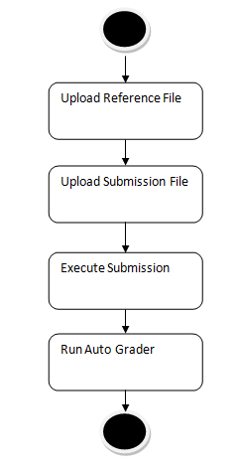
FLOW CHART
ACTIVITY FLOW:

Slide 18
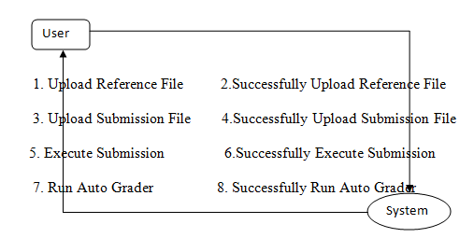
FLOW CHART
DATA FLOW:

Slide 19
ALGORITHMS
AUTOGRADER
We have implemented this novel approach using a tool called AUTOGRADER
AUTOGRADER is a tool that automatically determines the correctness of program.
We can determine the correctness of the submission and provide counter examples for an incorrect submission.
AUTOGRADER, a tool that automatically provides real-time judgments with counterexamples for programming exercises in introductory programming courses.

Slide 20
ALGORITHMS
AUTOGRADER:
Firstly the instructor have to submit the reference file and when the student submit the solutions it checks for the student submitted data and instructor submitted reference solution.
If one or more dissimilarities are found, the submission is decided as incorrect; otherwise, the submission is decided as correct.
When the students submitted solutions does not match with the reference solution then AUTOGRADER gives the explanation about why it is incorrect .

Slide 21
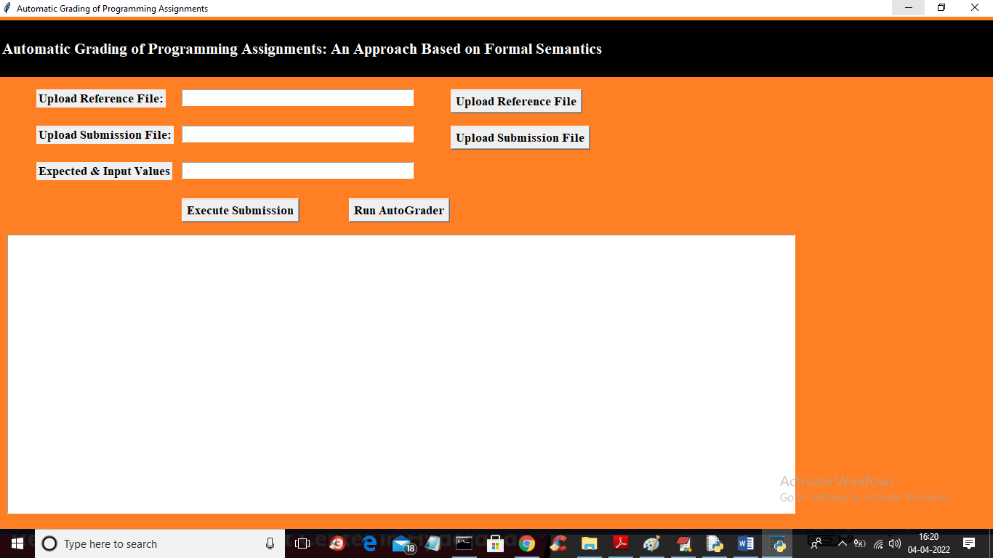
RESULTS OBTAINED
In above screen click on ‘Upload Reference File’ button to upload file

Slide 22
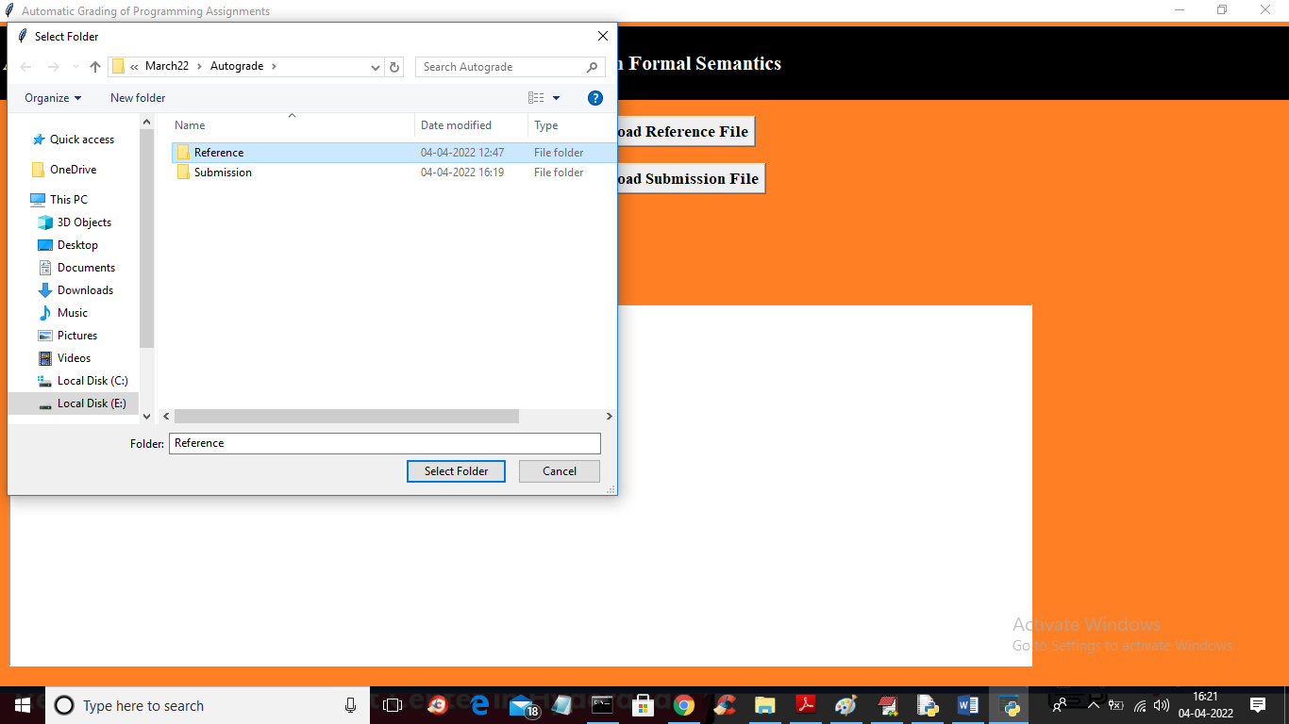
RESULTS OBTAINED
In above screen selecting and uploading ‘Reference’ folder which contains reference file and then click on ‘Select Folder’ button to load file and get below output.

Slide 23
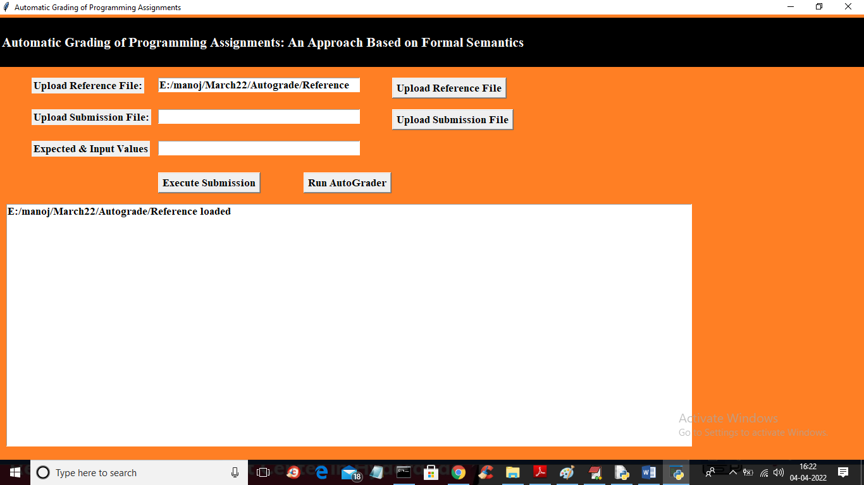
RESULTS OBTAINED
In above screen reference file loaded and now click on ‘Upload Submission Files’ button to upload submission files

Slide 24

RESULTS OBTAINED
In above screen selecting and uploading submission folder and then click on ‘Select Folder’ button to get below output

Slide 25
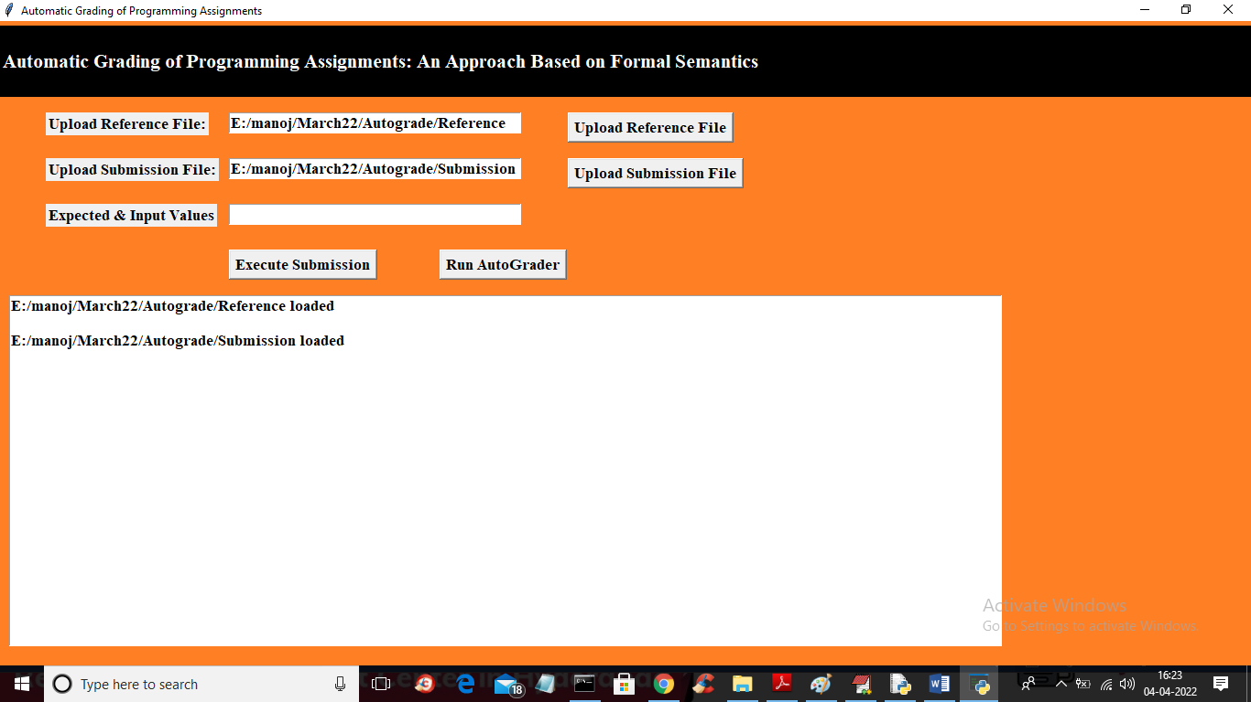
RESULTS OBTAINED
In above screen both reference and submission files are loaded and now in 3rd text field enter expected output and input values separated by comma like below screen.

Slide 26
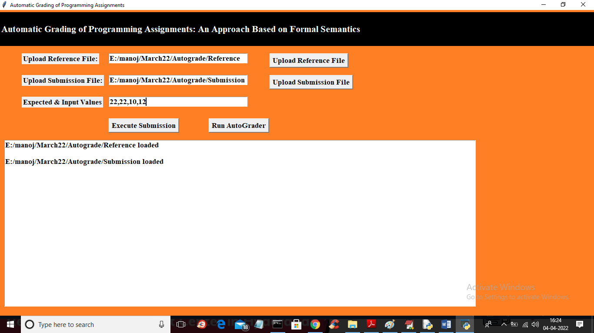
RESULTS OBTAINED
In above screen 3rd field I entered first output value as 22 and then enter 3 numbers to find maximum of those 3 numbers and we can out of last 3 numbers 22 is the maximum so expected output is 22 and below is the executed output

Slide 27
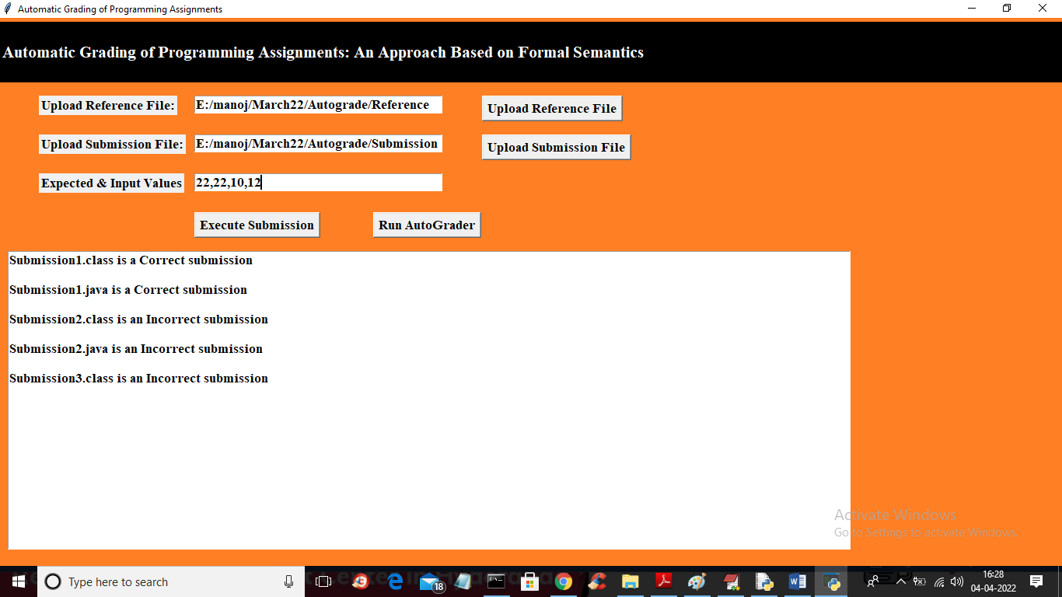
RESULTS OBTAINED
In above screen first two programs output was correct and logic also correct and 3rd and 4th got correct output but its logic is not right and 5th one got wrong executed output so its logic will also wrong

Slide 28
REFERENCES
[1] V. Ganesh and D. L. Dill, “A decision procedure for bit-vectors and arrays,” in International Conference on Computer Aided Verification. Springer, 2007.
[2] D. Gao, M. K. Reiter, and D. Song, “BinHunt: Automatically finding semantic differences in binary programs,” in International Conference on Information and Communications Security. Springer, 2008.
[3] W. Afzal, R. Torkar, and R. Feldt, “A systematic review of search-based testing for non-functional system properties,” Information and Software Technology, 2009.
[4] J. Ming, M. Pan, and D. Gao, “iBinHunt: Binary hunting with interprocedural control flow,” in International Conference on Information Security and Cryptology. Springer, 2012.

Slide 29
REFERENCES
[5] L. Gong, “Auto-grading dynamic programming language assignments,” University of California, Berkeley, Tech. Rep., 2014.
[6] D. Perelman, J. Bishop, S. Gulwani, and D. Grossman, “Automated feedback and recognition through data mining in code hunt,” Microsoft, Tech. Rep., 2015.
[7] J. M. Rojas, G. Fraser, and A. Arcuri, “Seeding strategies in searchbased unit test generation,” Software Testing, Verification and Reliability, 2016.

Slide 30
PYTHON MODULES
tkinter: A standard GUI toolkit for Python that allows you to create desktop applications with graphical user interfaces.
os: A module that provides a way of using operating system-dependent functionality to the file system.
Subprocess: The Python subprocess module is a tool that allows you to run other programs or commands from your Python code. It can be used to open new programs, send them data and get results back. It's like giving commands to your computer using Python instead of typing them directly into the command prompt.

Slide 31
PYTHON MODULES
numpy: A powerful library for numerical computing in Python, offering support for large, multi-dimensional arrays and matrices, along with a collection of mathematical functions to operate on them.
re: Python has a built-in module named re that is used for regular expressions in Python. We can import this module by using the import statement.
filedialog: The filedialog module in Python provides classes and functions for creating file and directory selection windows. The module is part of the Tkinter library, which is a popular choice for building basic graphical user interface (GUI) applications in Python.

Slide 32
CODE
from tkinter import *
import tkinter
from tkinter import filedialog
from tkinter.filedialog import askopenfilename
import numpy as np
import os
import subprocess
import os
import re
main = tkinter.Tk()
main.title("Automatic Grading of Programming Assignments")
main.geometry("1300x900")
global refrence_file, submission_file, incorrect, code_samples
def uploadReference():
global refrence_file
text.delete('1.0', END)
refrence_file = filedialog.askdirectory(initialdir=".")
text.insert(END,refrence_file+" loaded\n\n")
tf1.insert(END,refrence_file)
def uploadSubmission():
global submission_file
submission_file = filedialog.askdirectory(initialdir=".")

Slide 33
CODE
text.insert(END,submission_file+" loaded\n\n")
tf2.insert(END,submission_file)
def executeSubmission():
global submission_file, refrence_file, incorrect
incorrect = []
text.delete('1.0', END)
expected = tf3.get()
array = expected.split(",")
parent_file = submission_file
print(parent_file)
submissions = os.listdir(submission_file)
for i in range(len(submissions)):
if '.class' not in submissions[i]:
out=subprocess.run('javac '+parent_file+'/'+submissions[i],stderr = subprocess.PIPE, shell=True)
msg = out.stderr.splitlines()
if len(msg) == 0:
exe_name = submissions[i].split(".")
out = subprocess.check_output('java -classpath '+parent_file+' '+exe_name[0]+' '+array[1]+' '+array[2]+' '+array[3], shell=True)

Slide 34
CODE
output = out.decode().strip("\r\n").strip()
if output != array[0]:
incorrect.append(submissions[i])
text.insert(END,"Submission file: "+submissions[i]+" Generated Output: "+output+" Expected Output: "+array[0]+"\n\n")
def readFile(file_path):
data = ""
with open(file_path, "r") as file:
for line in file:
line = line.strip('\n')
line = line.strip()
arr = line.split(" ")
if len(arr) >= 2:
if arr[0].strip() == 'if' or arr[1].strip() == 'if':
data += line+" "
file.close()
data = data.strip()
return data
def calculateDiversePath(reference, submission):
reference = re.sub('[()=]', '', reference)
submission = re.sub('[()=]', '', submission)
arr = submission.split(" ")
return len(arr)

Slide 35
CODE
def autoGrader():
global submission_file, refrence_file, code_samples
code_samples = []
text.delete('1.0', END)
reference = readFile(refrence_file+"/Ref1.java")
code_samples.append(reference)
submissions = os.listdir(submission_file)
for i in range(len(submissions)):
if '.class' not in submissions[i]:
code = readFile("Submission/"+submissions[i])
code_samples.append(code)
for i in range(1,len(code_samples)):
diverse=calculateDiversePath(code_samples[0],code_samples[i])
if diverse > 6:
text.insert(END,submissions[i-1]+" is an Incorrect submission\n\n")
else:
text.insert(END,submissions[i-1]+" is a Correct submission\n\n")
font = ('times', 16, 'bold')
title = Label(main, text='Automatic Grading of Programming Assignments: An Approach Based on Formal Semantics',anchor=W, justify=LEFT)
title.config(bg='black', fg='white')
title.config(font=font)

Slide 36
CODE
title.config(height=3, width=120)
title.place(x=0,y=5)
font1 = ('times', 13, 'bold')
l1 = Label(main, text='Upload Reference File:')
l1.config(font=font1)
l1.place(x=50,y=100)
tf1 = Entry(main,width=35)
tf1.config(font=font1)
tf1.place(x=250,y=100)
referenceButton = Button(main, text="Upload Reference File", command=uploadReference)
referenceButton.place(x=620,y=100)
referenceButton.config(font=font1)
l2 = Label(main, text='Upload Submission File:’)
l2.config(font=font1)
l2.place(x=50,y=150)
tf2 = Entry(main,width=35)
tf2.config(font=font1)
tf2.place(x=250,y=150)
submissionButton = Button(main, text="Upload Submission File", command=uploadSubmission)
submissionButton.place(x=620,y=150)
submissionButton.config(font=font1)
l3 = Label(main, text='Expected & Input Values')
l3.config(font=font1)
l3.place(x=50,y=200)

Slide 37
CODE
tf3 = Entry(main,width=35)
tf3.config(font=font1)
tf3.place(x=250,y=200)
executeButton = Button(main, text="Execute Submission", command=executeSubmission)
executeButton.place(x=250,y=250)
executeButton.config(font=font1)
autoButton = Button(main, text="Run AutoGrader", command=autoGrader)
autoButton.place(x=480,y=250)
autoButton.config(font=font1)
text=Text(main,height=20,width=120)
scroll=Scrollbar(text)
text.configure(yscrollcommand=scroll.set)
text.place(x=10,y=300)
text.config(font=font1)
main.config(bg='chocolate1')
main.mainloop()

Slide 38
QUERIES?

Slide 39
THANK YOU

